Slide 1
Palliation to Resuscitation; when to treat the palliative patient?
Dr Nicholas Herodotou, Palliative Medicine Consultant
L&D University Hospital

Slide 2
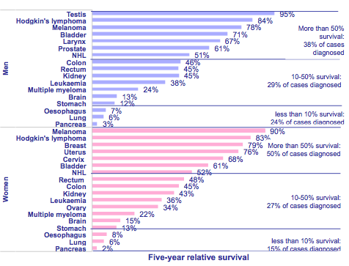
UK 5 yr survival rates

Slide 3
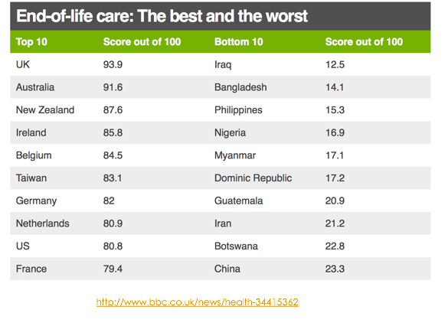
UK end-of-life care 'best in world'

Slide 4
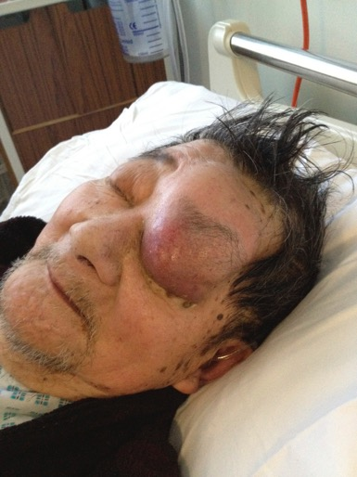

Slide 5
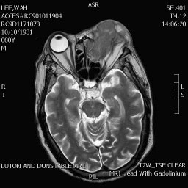

Slide 6
Definition of palliative care
Holistic multidisciplinary care of patient (& family) suffering from a progressive, incurable, life limiting illness.
Aim is to give QUALITY and not quantity to their life
Physical, psychological, social & spiritual

Slide 7
Definitions
Palliative patient
  Metastatic disease
  Months-years survival
  Treatment maintains quality of life only
  Dying
    Approaching end of life: hours-days survival
End of Life Care (EOLC)
  Planning in last year of life
  Cancer & non-cancer

Slide 8
Prognostication

Slide 9
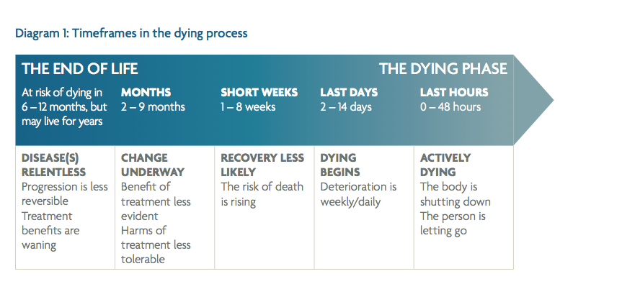
Extracted from More Care Less Pathway, a Review of the LCP

Slide 10
When is a patient dying?
Clinically deteriorating
No reversibility
Bed bound
Poor oral intake
Francis I at the dying Leonardo da Vinci by Louis Gallait

Slide 12
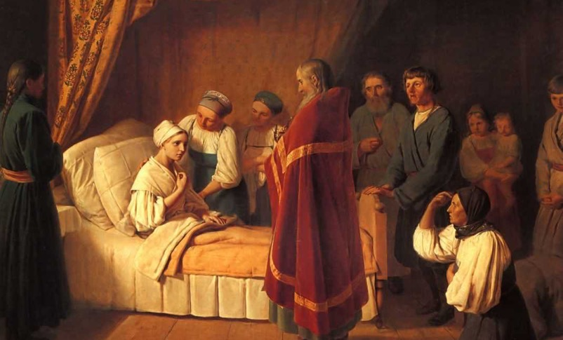
Preparing for a natural death
Administration of the Eucharist to a dying person (painting by19th-century artist Alexey Venetsianov)

Slide 13
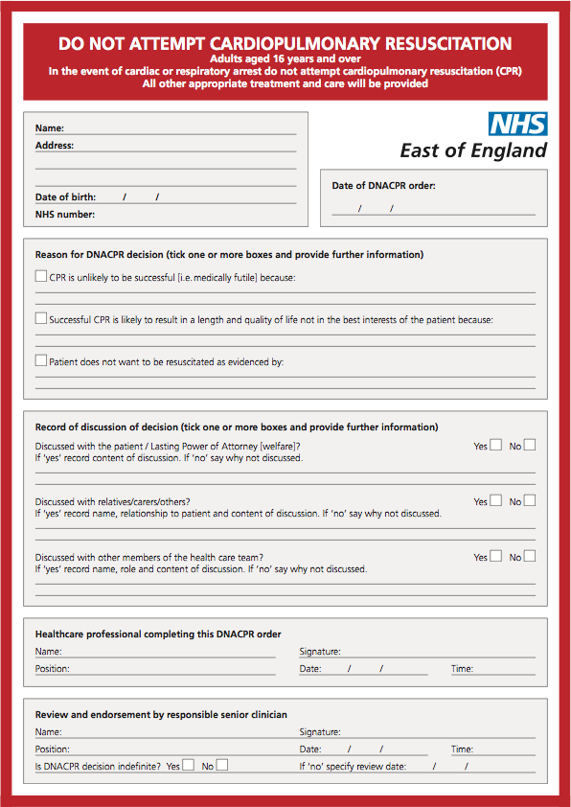
DNACPR

Slide 14
“If you talk to a man in a language he understands, that goes to his head. If you talk to him in his language, that goes to his heart.”
Nelson Mandela

Slide 15
Prof of Oncology letter to patient….
“..This lady was seen straight after a CT scan on the 15 Jan 2015. The scan unfortunately shows that her tumour has progressed. Very distressed when seen in clinic as she is continuously feeling nauseated. I had a frank discussion with her that there was no more treatment that we can offer her and that she knows that she is dying…
If she is unable to eat and her symptoms are poorly controlled, she could survive just a few weeks, but if her symptoms are better controlled and she manages to eat, she could survive a few months”
The patient didn't know she was dying until receiving this letter!

Slide 16
Ethical principles
Autonomy
Beneficence
Non-maleficence
Justice

Slide 17
When to resuscitate (Not DNACPR)
Benefit >harm
Treatable reversible causes: HCOM, anaemia, sepsis
Quality of life

Slide 18
When NOT to resuscitate
Last hours-days life (terminal phase)
Quality of life not enhanced by treatment
Harm > benefit

Slide 19
We often get it wrong due to…
Not communicating with patient/family
Not knowing when to stop treatment
Not identifying the dying patient

Slide 20
Three Case reports
A patient who should have been resuscitated
A patient who should NOT have been resuscitated x2

Slide 21
Case report 1:The need to resuscitate
Mrs AR 64 yrs old, known IDDM
Diagnosed 22.12.10 with left lung cancer, T2, N2, M1 on CT
25.12.10 Radiotherapy to spine for cord compression
7.1.11, discharged from L&D with NSAIDS and morphine
12.1.11, biopsy of lung mass- SCLC

Slide 22
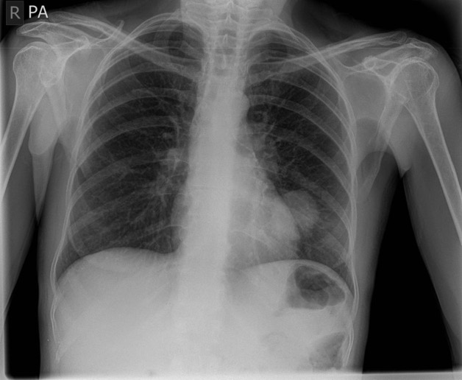

Slide 23
19.1.11, seen by oncologist, not well, delay chemotherapy for one month
20.1.11, A&E, unwell, N&V, septic, confusion, drowsy
Dehydrated, ARF, thrombocytopenia
Bloods: urea 35, creat 173, platelets 96, Na 125, K 6.6, ca²⁺ (uncorrected) 1.60
Patient was to be sent home for EOLC as deemed dying

Slide 24
Mac nurse saw patient, not happy so I was asked to review
Patient was drowsy, myoclonic jerks
Diagnosis: NSAID induced acute renal failure causing opioid toxicity, potentially reversible & treatable condition. Low platelets 2nd to NSAID use
Advised to admit to L&D & treat ARF

Slide 25
Management
IV fluids
USS kidneys & treat high K⁺
Stop NSAID, MST, gabapentin
Syringe driver: midazolam 5mg, Oxynorm 10mg, cyclizine 150mg

Slide 26
Patient worsened
Syringe Driver (SD) stopped overnight by registrar
Re-started on diamorphine PRN only as no Oxynorm on ward
Put on end of life care
Re-started SD: diamorphine 10mg, midaz 10, cyclizine 150mg
RIP 21.1.11

Slide 27
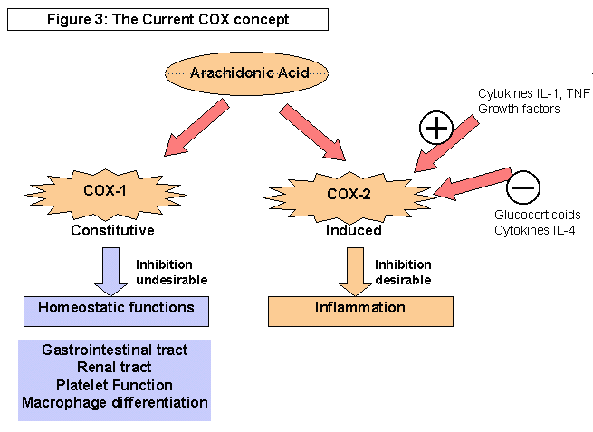
http://www.arthritis.co.za/cox.html

Slide 28
Death’s from NSAID’s
http://www.bandolier.org.uk/booth/painpag/nsae/nsae.html

Slide 29
Why it was appropriate to treat this patient?
Potentially reversible iatrogenic condition
Potential candidate for chemotherapy
Was not dying directly from newly diagnosed cancer
Morphine metabolites (M3G & M6G) not eliminated in ARF causing severe toxicity

Slide 30
Case report 2: Not to resuscitate
Mrs TS 56 year old Pakistani
Diffuse large B-cell lymphoma, stage 4 (Dec 2010), IDDM, AF
Progressive/relapsed October 2011, chemo trial stopped
Axilla tumour mass increased by 20cm from Aug-Oct 2011
Initially admitted Dec 2011 with HB 6, platlets 9, neut 2

Slide 31
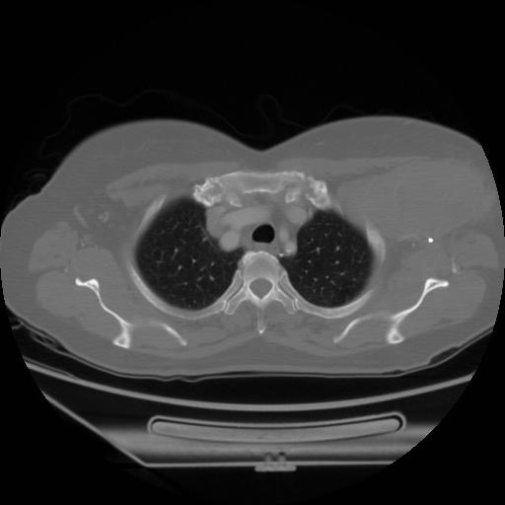

Slide 32
Transfused, hydrated and given radiotherapy to mass (15F, finished 27.12.11)
Family reluctant for community Macmillan input
Not willing to discuss EOLC with haematologist
Sent home, HB falling rapidly so being monitored

Slide 33
4.1.12
Was due at Keech Day hospice for blood test but had ?coffee ground vomit
Husband brought her to A&E
C/O unwell, high temp 38.5, abd pain
Bloods: HB 9.4, WCC 5.9, Neut 5.65, plat 10, U&E ok, ca²⁺ NA

Slide 34
Management
Haematologist already advised medical team to give 1 bag platelets
I was asked to see patient for advice on pain control
Patient appeared to be terminally ill, prognosis hours-days
Expressed my concern of futility of platelets to family & that she may die quickly
Patient needs to go home/hospice with syringe driver and EOLC

Slide 35
I signed the DNACPR form
I reluctantly agreed to allow patient to have platelet transfusion then home immediately from A&E
Syringe driver started: morphine 20mg & midazolam 5mg
No benefit for OGD: risk>harm
Explained that patient high risk of internal bleeding and not reversible due to falling platelets

Slide 36
Discharge Liaison arranged for immediate transfer home after transfusion
Patient admitted to ward as high temp & family wanted admission & for home the following day
Transferred to ward with IV fluids (not advised by myself)
Respiratory rate suddenly falls, unresponsive
Family verbally aggressive demanding nursing staff to give o₂ & to resuscitate patient despite DNACPR form signed

Slide 37
Security arrived to ward to control family
Patient RIP 0250, 5.1.12
Family demanded Death Certificate (DC) to bury within 24hrs
Death Certificate done by doctor who had not seen patient alive before death (illegal)
Registrar of Births, Death & Marriages refused DC
I was asked to re-do DC

Slide 38
Why NOT appropriate to resuscitate?
Advanced progressive cancer, decreasing platelets from Nov 2011
Platelet transfusion gives no symptom relief
Bed bound and barely eating/drinking
Family wanted patient to die at home but died in L&D
Family have no legal right to demand a treatment

Slide 39
Case 3
71yr severe dementia
FNOF R hip March 2013 in nursing home
R Hemiarthroplasty 01/3/13
Bed bound, kept dislocating so prosthesis removed 2013
PMH: Pernicious anaemia, pressure sores

Slide 40
Husband hand written letter given to nursing home
Acted as an Advanced Care Plan (ACP)
Specifically requested no hospital admission
Patient became dehydrated
GP admitted to hospital 24.11.18

Slide 42
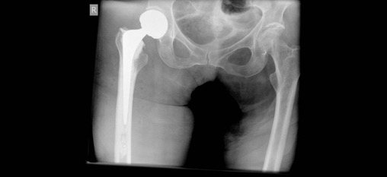
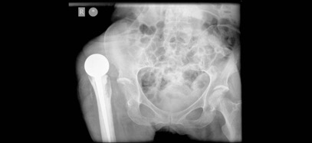
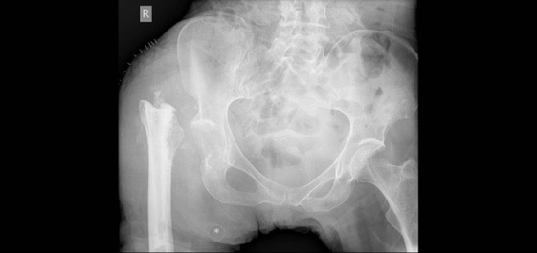
March 2013

Slide 44
Husband showed his letter to GPOOH-said she needed IV fluids as dehydrated, husband asked to make decision
Treated with IV fluids & AB’s
In hospital 72 hrs
Ward sister asked for my input

Slide 45
Outcome
Patient unresponsive-dying!
O₂ mask on face
Stopped all further treatment
Fast tracked back to nursing home to die
Died next day

Slide 46
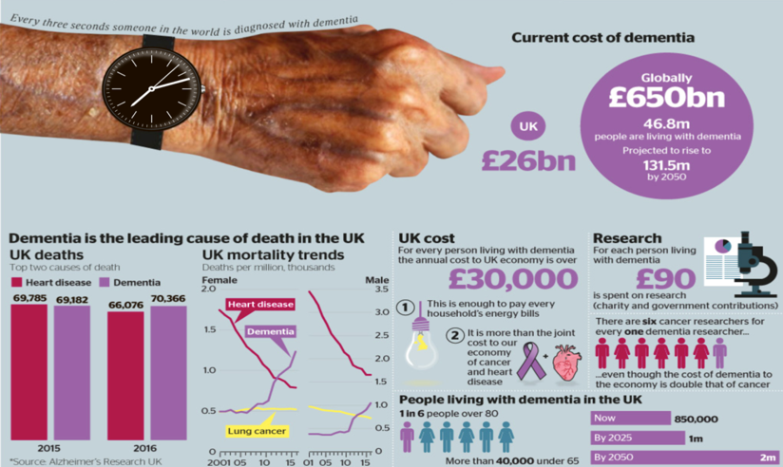
The Times Newspaper 12.03.18

Slide 48
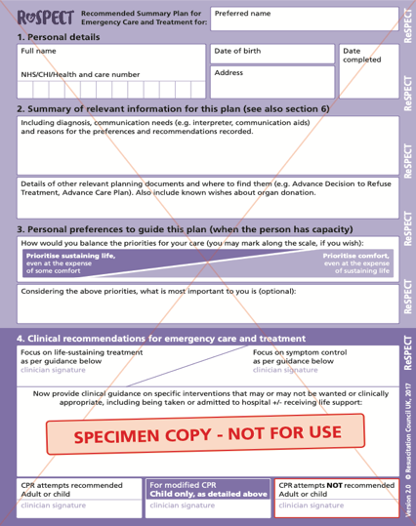
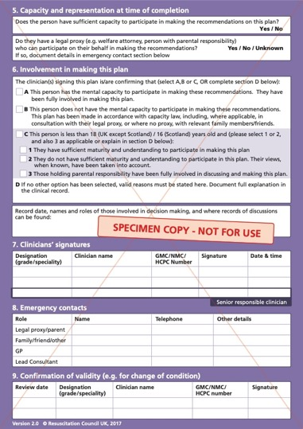

Slide 50
Summary: Improving End of Life Care (EOLC)
Identifying the dying phase
DNACPR
Proper use of opiates
Ethical management & support/advice from palliative care team
Exclude reversible causes

