Slide 1
Diabetes Mellitus in Primary Care
Dr A R Ebrahim
GP with Special Interest in Diabetes

Slide 2
Objectives
Describe how diabetes is diagnosed and classified
Describe non diabetes hyperglycaemia (NDH)
Who may be screened for Type 2 Diabetes
How to organise the care of a person with diabetes in primary care
Nice guidelines with regards to newer agents

Slide 3
Basic pathophysiology for glucose intolerance
Insulin is produced within Beta islets cells
Glucose intolerance/hyperglycaemia results:
Insulin resistance
Beta cell dysfunction

Slide 4
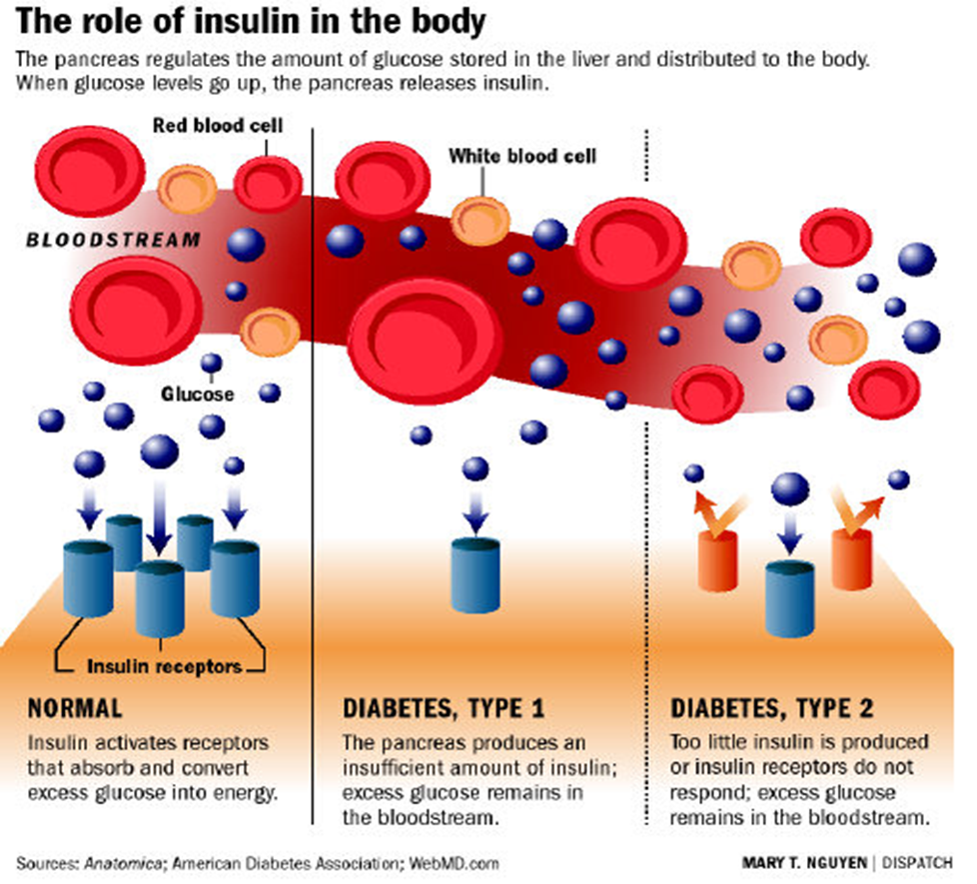

Slide 5
Causes of Hyperglycaemia
Beta cell dysfunction
Reduction/arrest of insulin production
Autoimmune → Type 1 Diabetes
Insulin resistance
Insulin action is decreased by Insulin receptor dysfunction → Type 2 Diabetes

Slide 6
Classification
Out dated terms no longer in use:
Insulin dependent diabetes mellitus IDDM
Non insulin dependent diabetes mellitus NIDDM
Often people equated IDDM as Type 1 and NIDDM Type 2 so when a NIDDM went on insulin they became Type1??

Slide 7
Classification
Should use the following terms:
Type 1 DM or Type 2 DM
Rare types:
LADA - Latent Autoimune Daibetes of Adult (late onset Type 1)
MODY - Mature Onset Diabetes of Young (monogenic)

Slide 8
Symptoms on presentation
Osmotic Symptoms
Excess thirst
Polyuria
Urinary incontinence
Blurred vision/changes in visual acuity
Extreme Tiredness
Non Osmotic symptoms
Weight loss
Recurrent Pruritis Vulvae/Balantis
Recurrent infections/abscesses
Erectile Dysfunction

Slide 9
Case Study
Shirley is 52 years old has presented at practice for a discussion on HRT as she is feeling very tired, run down and has recurrent thrush. She attributes her symptoms to her menopause. A random BM is 15.0
Past Medical History Social History Medication
Hypertension 3 years Works as part time cook Ibuprofen 200mg tds
Gest DM in 3rd pregnancy Married with 3 children Bendroflumethiazide
Obese Inactive
Ex-smoker
Is it diabetes or not?
Type 1 or Type 2?

Slide 10
Diagnostic Criteria
Diabetes Mellitus
Fasting venous plasma glucose | ≥ 7.0 mmol/l | or
Random or 2hr post glucose load | ≥ 11.1 mmol/l | or both
Non Diabetic Hyperglycaemia (NDH)
Fasting blood glucose | 5.5-6.9 mmol/l | or
HbA1c | 42-47 mmol/mol | or both
Impaired Glucose Tolerance (IGT)
Fasting (if measured) | < 7.0 mmol/l | and
2hr | ≥ 7.8 mmol/l and ≤ 11.0 mmol/l
Impaired Fasting Glucose (IFG)
Fasting | ≥ 6.1 mmol/l and <7.0 mmol/l | and
2hr (if measured) | < 7.8 mmol/l

Slide 11
Diagnosis of Diabetes
Requires 1 abnormal glucose if symptomatic (osmotic symptoms)
Requires 2 abnormal glucose if asymptomatic
Fasting Plasma Glucose (FPG) ≥ to 7mmol/l OR
2hr post glucose load ≥ equal to 11.1 mmol/l OR
HbA1c ≥ 48mmol/mol (6.5%)

Slide 12
HbA1c measures how much glucose coats the red blood cells

Slide 13
HbA1c
We now have local agreement with L&D to use HBa1c for screening for diabetes
Measures glycation of Haemoglobin in RBC its dependent their rate of cell turnover so it can give false negatives
Should not be used for diagnosis in:
Children
Pregnancy
Suspected Type 1/acutely ill will not pick rapid raised hyperglycaemia
Drugs which cause rapid rise of glucose ie steroids/antipsychotics
Abnormal haemoglobin variant which reduce RBC turnover
Anaemia from haemolysis/iron deficient/chronic renal failure

Slide 14
Diagnosing using HbA1c
WHO recommendation
HbA1c ≥ 48mmol/mol (6.5%) Is diagnostic of DM
(Variation between ethnicity could be 4mmol/mol between European/African)
As HBa1c measures glycation of Haemoglobin in RBC its dependent their rate of cell turnover
Should not be used for diagnosis in:
Children
Pregnancy
Suspected Type 1/acutely ill will not pick rapid raised hyperglycaemia
Drugs which cause rapid rise of glucose ie steroids/antipsychotics
Abnormal haemoglobin variant which reduce RBC turnover
Anaemia from haemolysis/iron deficient/chronic renal failure

Slide 15
New protocol for screening for Type 2 Diabetes
If one fasting glucose above 7 mmols/l repeat the test add FBC.
If the second is between 5.5-6.9 mmol/l, request a HbA1c provided not anaemic and not fall in the special risk group.
If anaemic or falls in the special risk group then request OGTT

Slide 16
Non Diabetic Hyperglycaemia
NDH - new term for pre-diabetes; impaired glucose regulation.
NDH – includes impaired fasting glycaemia (IFG) and impaired glucose tolerance (IGT).

Slide 17
Non Diabetic Hyperglcaemia
NDH is currently diagnosed by HbA1c or FBS
Fasting blood sugar: 5.5-6.9 mmol/l
HbA1c is >42(6.0%) and equal to 47(6.4%) mmol/mol

Slide 18
Importance of NDH/Pre-diabetes?

Slide 19
Individuals with NDH are at increase of T2DM
On average incidence 46.9 patients per 1000 patient/year. (CI 15.14-89.71)
Morris DH, Khunti K, Achana F, Srinivasan et al. Progression rates from HbA1c 6.0-6.4% and other prediabetes definitions to type 2 diabetes: a metaanalysis. Diabetologia. 2013 Jul; 56(7):1489-93.

Slide 20
NDH increases risk of CV disease.
Individual with pre-diabetes have RR 1.2 for CV disease (CI 1.2- 1.28)
Ford ES, Zhao G, Li C, Pre-diabetes and the risk for Cardiovascular disease: a systematic review of the evidence. J Am Coll Cardiol. 2010 Mar 30; 55(13):1310-7

Slide 21
Impaired Fasting Glycaemia
Fasting Plasma Glucose between 6.1 & 6.9 mmol/l
2 hours post glucose load <7.8 mmol/l

Slide 22
Impaired Glucose Tolerance
During an OGTT
Fasting Plasma Glucose < 7.0 mmol/l and
2 hours post glucose load ≥ to 7.8 and<11.0 mmol/l

Slide 23
Indications for OGTT
Requires results of two fasting plasma glucose test within 3 months where:
Inconclusive i.e one above and the other below 7.0mmol/l
Between 6.1and 6.9mmol

Slide 24
Diagnosing using HbA1c
WHO recommendation
HbA1c ≥ 48mmol/mol (6.5%) Is diagnostic of DM
(Variation between ethnicity could be 4mmol/mol between European/African)
As HBa1c measures glycation of Haemoglobin in RBC its dependent their rate of cell turnover
Should not be used for diagnosis in:
Children
Pregnancy
Suspected Type 1/acutely ill will not pick rapid raised hyperglycaemia
Drugs which cause rapid rise of glucose ie steroids/antipsychotics
Abnormal haemoglobin variant which reduce RBC turnover
Anaemia from haemolysis/iron deficient/chronic renal failure

Slide 25
Will an individual diagnosed as T2DM by an OGTT be diagnosed T2DM using Hba1c?

Slide 26
Not always!!
The two test actually diagnose two different populations.
The populations do overlap but not mutually inclusive.
Hence do not use both test, pick one

Slide 27
Diabetes Prevention Programmes
There is no national screening programme recommended
Diabetes prevention programme:
Aims to identify high risk individuals using risk assessment tools i.e. Q-Diabetes
Those with high risk scores will have fasting bloods sugars or HbA1c to determine NDH/Diabetes

Slide 28
Diabetes Prevention Programmes
All Caucasian over 40 yrs with first degree relative with T2DM will be offered complete a risk assessment tool
In Asian/Black individual over 25yrs with first degree relative with T2DM will be offered to complete a risk assessment tool
Those with a high risk score should be offered fasting bloods sugar or a HbA1c
Should be repeated between 3-5 years.

Slide 29
Pre-diabetics-High risk of DM
Diabetes Prevention Programme
HbA1c 42-47mmol/mo1 (6-6.4%)
Provide intensive lifestyle advice
Educate to report symptoms of diabetes
Monitor HbA1c annually

Slide 30
Organising Care in Primary Care
38 yr old male works as a manager with a BMI of 27, is complaining of increase thirst, passing lots of urine, tired all the time. Has had his FPG returned as 9.5mmol. How will organise his care?

Slide 31
Organising Care in Primary Care
Inform him of the diagnosis
Give brief dietary intervention
Request HbA1c, Lipids & U&E with follow up
Book appointment for annual check
Book for in house dietary education
Need booking for Structured Education
Need ensure referred for retinal screening

Slide 32
Anti-hyperglycemic drugs
Biguanides
Sulfonylurea
DDP4 inhibitors
GLP 1 analogues
SGLT2 Receptor inhibitors

Slide 34
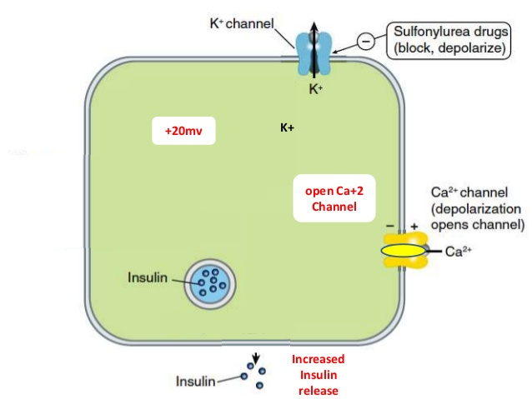
Pharmacology of Sulfonylurea

Slide 35
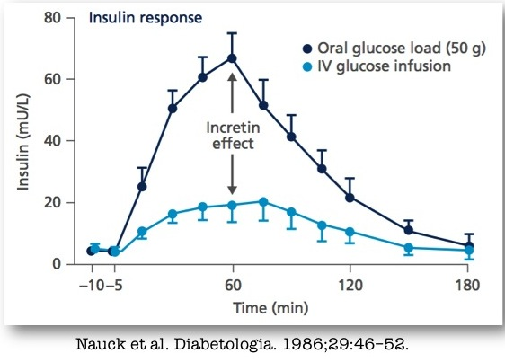
Incretin Effect

Slide 36
Pharmacology of GLP1 analogue

Slide 37
DPP-4 inhibitors

Slide 38
DPP-4 inhibitors
Prolongs the effect of the incretin hormones on Beta cells, stimulating insulin secretion
Have a weight neutral effect, mainly lower post-prandial sugars and very low risk of hypoglycaemia
Can be used second line if there is a significant risk of hypoglycaemia need to justify.
Mainly used third line after a sulfonylurea
Should only continue their use, if one achieves a HbA1c reduction of 0.5% (6mmol/mol) within 6months from initiation.

Slide 39
GLP 1 analogues

Slide 40
GLP 1 analogues
Used as third line if BMI > 35
Used in third line if BMI <35 if insulin is unacceptable because of occupation or need weight loss to benefit co-morbidities
Only continue if achieve a reduction in HbA1c of at least 1 %(11mmol/mol) and weight loss at least 3% of initial body weight at 6months

Slide 41
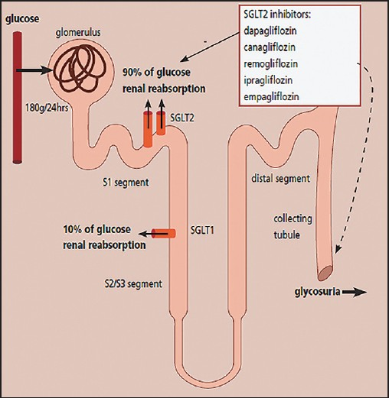
Pharmacology of SGLT2 inhibitors

Slide 42
SGLT2 Inhibitors
Block glucose reabsorption from the proximal renal tubules.
Associated of loss of calories associated with a weight loss
Need good functional kidneys
Licensed to be used in monotherapy onwards
Often good second or third line drug
Consider in obese patients

Slide 43
Case Study
Tom has recently been informed that he has type 2 diabetes he is 45 years old with a BMI of 25.3 and was asked to have a HbA1c blood test. This has come back as being 7.4% (57mmol/mol). He is here today for his first review after his diagnosis.
1. What aspects of care are you going to ensure have been or will be covered today?
2. What agent are you going to initiate to improve his glycaemic control?
3. In which scenario would you delay initiating oral hypoglycaemic agents?

Slide 44
1. a. Organise an annual check
b. Provide in house lifestyle and exercise advice
c. Refer to a structured education programme
d. Refer to a retinal screening programme
e. Commence treatment
2. Metformin
3. If the patient was asymptomatic and his HbA1c was below 6.5%.(48mmol/mol)

Slide 45
Case Study
Ali has had type 2 diabetes for the last 2 years. He is currently taking 45mg of pioglitazone which he tolerates well. His BMI has reduced from 27 to 26 and has regular exercise. He works as an office manager and is not affected with hypoglycaemic episodes. Since his diagnosis his HbA1c has ranged between 6.5(48mmol/mol) to 7% (53mmol/mol). Recently his HbA1c has started to rise his previous level was 7.3%(56mmol/mol) and his current one has come back at 7.5% (58mmol/mol) despite having received reinforcement of lifestyle advice.
1. Why do you think he was prescribed pioglitazone as first line?
2. What is your likely second line oral hypoglycaemic drug group?
3. If his BMI was 31 would be your options be for a second line drug group?

Slide 46
1. Not tolerate metformin s/e or it was
contra-indicated
2. Sulfonylureas
3. SGLT2 inhibitors and DPP4 inhibitors

Slide 47
Case Study
Edna is a 70 year old lady living quite independently on her own with type 2 diabetes for the last 5 years. Her BMi is 26 and has been well controlled on metformin maximum dose. Recently her HbA1c her increased to 8% (64mmol/mol) from 7.4% (57mmol/mol) has tried to be as active as possible and keeps to a healthy diet.
1. What important issues do you want to discuss with Edna before you consider your second line medication?
2. What is your second line drug group choice likely to be?

Slide 48
1. Discuss risk of hypoglycaemia, how to recognise and how to manage. Ensure no symptoms of heart failure.
a. Gliclazide 40mg in mane & review for hypo
b. DPP4 inhibitors
c. Pioglitazone has increase risk fracture and bladder cancer need to take risks of this into account. If starts to get SOB rule out heart failure.
d. Is there a role for a SGLT2 inhibitor?

